Slide 1


PS8 SKILLSET MANAGEMENT SOLUTION
team：
ONE PIECE
members：Zhang Yipei
Sun Yitong
Azmi Naufal
Zhu Jiaying
2022.10
ONE PIECE

Slide 2
Catalogue
01
Introdution
02
Employee Side
03
Employer Side
04
Prospect
ONE PIECE

Slide 3
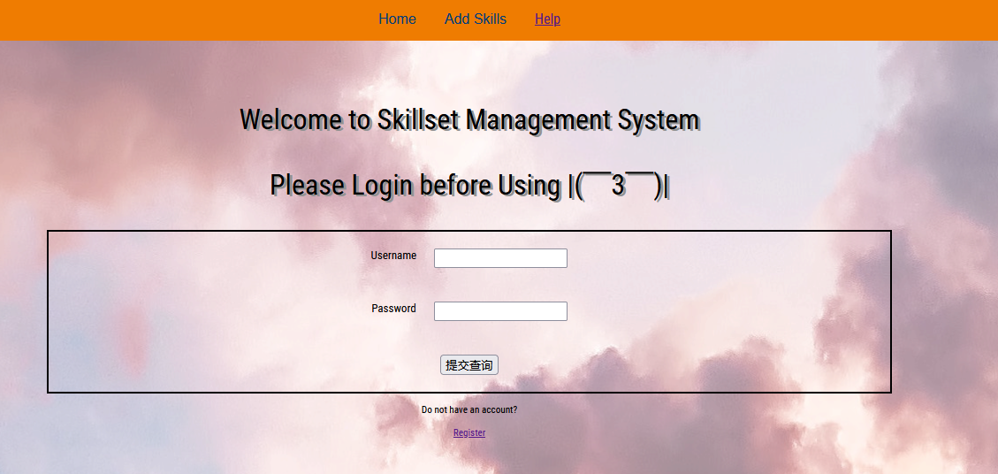
Introduction
Employee Side
Employer Side
Prospect
With more needs for the company to know about the skills of employees, we build a system allowing employees to submit and modify their skill certificates. At the same time, PSA can verify, extract and consolidate employee’s data through employer’s account.
ONE PIECE

Slide 4

Registeration:
Introduction
Employee Side
Employer Side
Prospect
Employees register their accounts at this page.
ONE PIECE

Slide 5

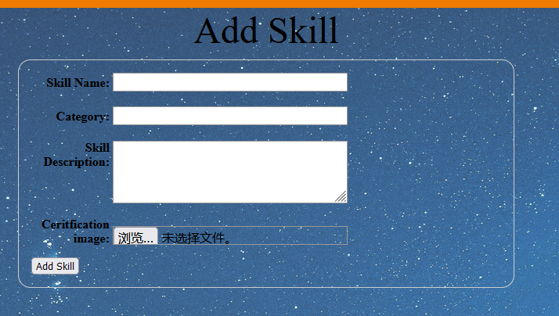

submit and see their skill certificates
Introduction
Employee Side
Employer Side
Prospect
ONE PIECE

Slide 6


Employers can know what skills employee’s own and who own this skill certificate.
Introduction
Employee Side
Employer Side
Prospect
ONE PIECE

Slide 7
Introduction
Employee Side
Employer Side
Prospect
01
course recommendation
02
employee performance
Employer
Side
03
design what is the future skill that their employees need
04
see the what kind of skill that their employee excel at
ONE PIECE

Slide 8
Introduction
Employee Side
Employer Side
Prospect
01
give feedback about the course
02
suggest the employer about what kind of course that should be provided
Employee
Side
03
have restriction to what kind of course they able to take in the future
04
develop more board skill
ONE PIECE

